Slide 1
Why NoSQL will never kill SQL
Denis Reznik

Slide 2
About Me
Denis Reznik
Kyiv, Ukraine
Data Architect at Intapp
Microsoft Data Platform MVP
Co-Founder of Ukrainian Data Community Kyiv (PASS Chapter)
PASS Regional Mentor, Central and Eastern Europe
Co-author of “SQL Server MVP Deep Dives vol. 2”

Slide 3
SQL and NoSQL History

Slide 4
RDBMS
Ingress
System R
CODASYL
IMS
SQL
1960s
1970s
1980s
1990s
2000s
2011
2012
2019
Nowadays
E.F. Codd’s Paper
RDMS Commercial Success

Slide 5
Relational Model
Users
Key
Id | Name | CompanyId | RegisteredOn
1 | John Smith | 3 | 01/10/2005
2 | James Woods | 3 | 23/05/2010
Id | Name | Company | RegisteredOn | CAddress
1 | John Smith | Microsoft | 01/10/2005 | SE, Pike st. 5
2 | James Woods | Microsoft | 23/05/2010 | SE, Pike st. 5
Tuple
(Row)
Companies
Attribute
(Column)
Normalization
Relation
(Table)
Id | Name | Address
1 | Intapp | Kyiv, Klovsky desc. 7a
2 | Oracle | MI, Ocean dr. 13
3 | Microsoft | SE, Pike st. 5
1 NF
2 NF
3 NF
4 NF
5 NF

Slide 6
SQL
Result Set
Users
Id | Name | OpenedOn
2 | Jack S. | 12-07-2015
1 | James R. | 01-02-2015
4 | John D. | NULL
3 | Peter P. | 03-01-2016
Id | Name | OpenedOn
1 | John D. | 01-02-2015
2 | Jack S. | 12-07-2015
3 | Peter P. | 03-01-2016
4 | James R. | NULL
SELECT * FROM Users
ORDER BY Name
Sessions
Id | User_Id | Title | CreatedOn
1 | 5 | Big Data | 07/03/2014
2 | 256 | NoSQL | 09/09/2015
5 | 2 | SQL | 12/08/2015
SELECT
u.Name AS Speaker,
s.Title AS Session
FROM Sessions s
INNER JOIN Users u
ON s.User_Id = u.Id
WHERE u.Id = 2
Users
Id | Name | Phone
1 | Bill | +380678455732
2 | John | NULL
3 | Mike | +380501233427
Speaker | Session
John | SQL

Slide 7
MongoDB
Cassandra
Neo4j
Redis
ElasticSearch
Amazon Dynamo Paper
RDBMS
Ingress
System R
Object Databases
CODASYL
IMS
Google BigTable Paper
SQL
1960s
1970s
1980s
1990s
2000s
2011
2012
2019
Nowadays
E.F. Codd’s Paper
RDMS Commercial Success
#nosql
(Johan Oskarsson)

Slide 8
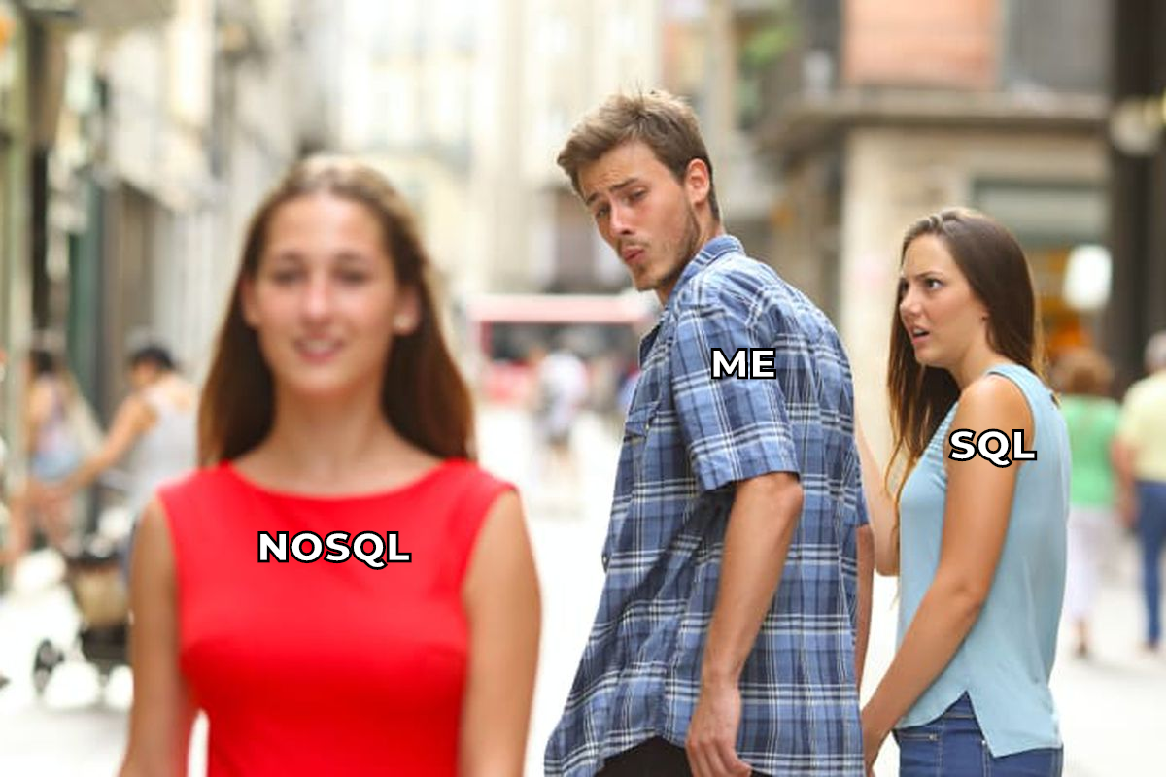

Slide 9
NoSQL Characteristics due to Martin Fowler
Non-Relational
Open-Source
Cluster-Friendly
21st Century Web
Schema-Less
Source: https://www.youtube.com/watch?v=qI_g07C_Q5I

Slide 10
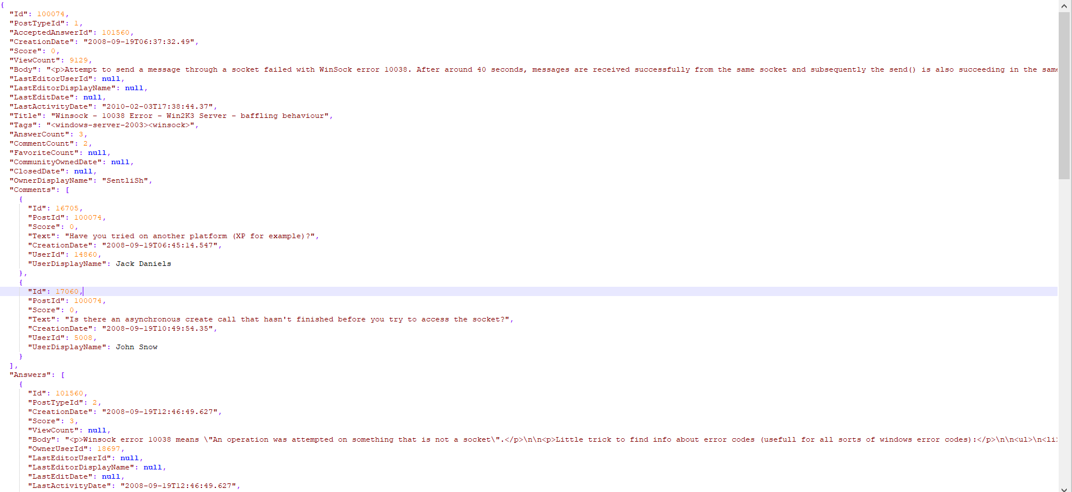
Schema-Less

Slide 11
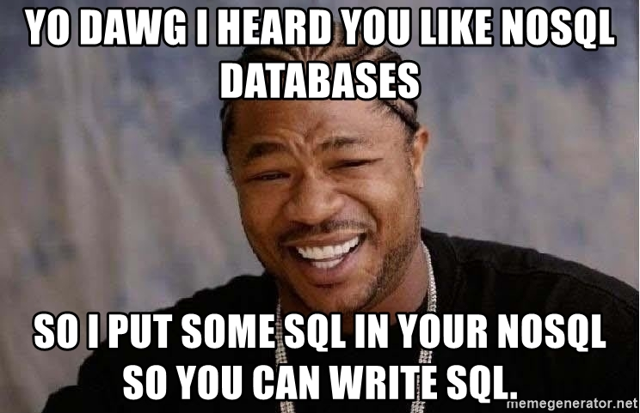
MongoDB
Cassandra
Neo4j
Redis
ElasticSearch
Amazon Dynamo Paper
MongoDB enable journaling by default
RDBMS
Ingress
System R
Object Databases
CODASYL
IMS
Google BigTable Paper
MongoDB 4.0
(ACID Transactions)
SQL
(?)
1960s
1970s
1980s
1990s
2000s
2011
2012
2019
Nowadays
E.F. Codd’s Paper
RDMS Commercial Success
#nosql
(Johan Oskarsson)
Martin Fowler said that NoSQL will not kill SQL

Slide 12
NoSQL Databases

Slide 13
NoSQL Databases
Key-Value
Redis
Column-Family
Cassandra
Graph
Neo4j
Time Series
Influx
Search
Elastic Search
Document
MongoDB

Slide 14
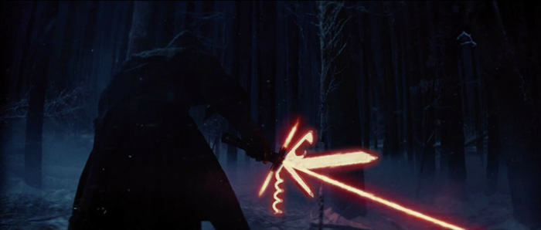
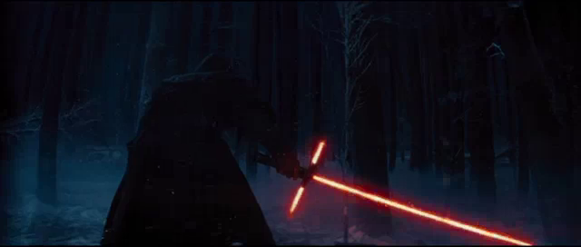
NoSQL
SQL

Slide 15
Cost and Open-Source

Slide 16
Relational Databases
SQL Server
Standard ~ $3717 per core
Enterprise - $14256 per core
Oracle Database
Standard - $17500
Enterprise - $47500
MySQL (annual subscription)
Standard - $2000 (1-4 sockets) - $4000 (5+ sockets)
Enterprise - $5000 (1-4 sockets) - $10000 (5+ sockets)
PostgreSQL
Free for commercial use
EnterpriseDB (?) - ?

Slide 17
NoSQL Databases
Redis
Enterprise Edition
Cassandra
DataStax Enterprise Cassandra
Neo4j
Enterprise Edition
Influx
Enterprise Edition
Elastic Search
Elastic Cloud Enterprise
MongoDB
Enterprise Edition

Slide 18
Cloud and Cost

Slide 20
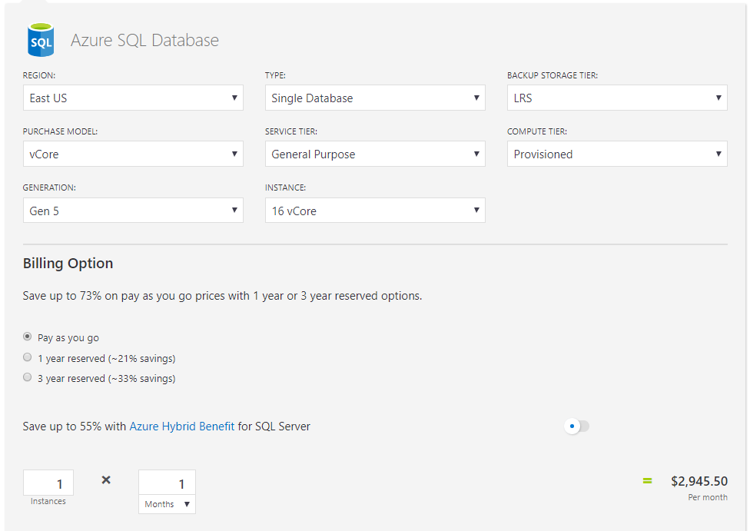
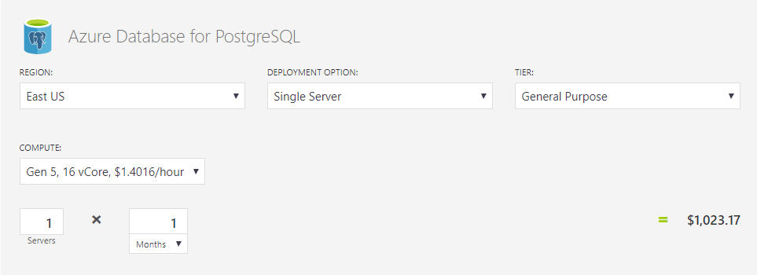

Slide 21
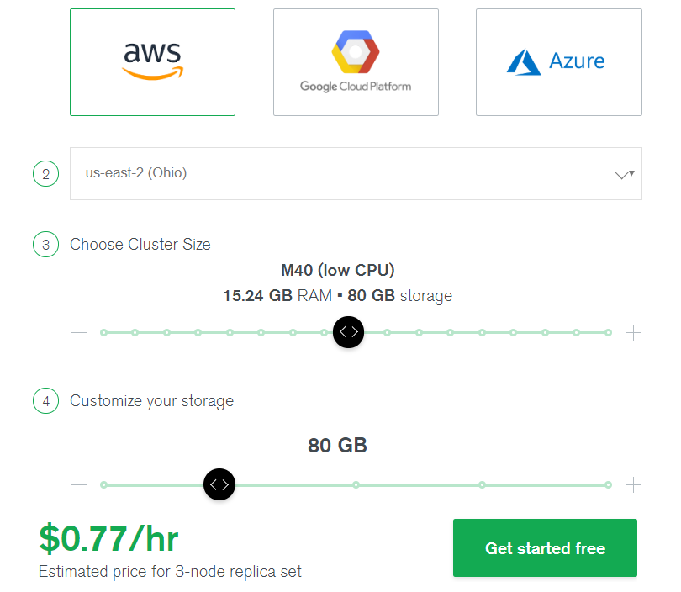
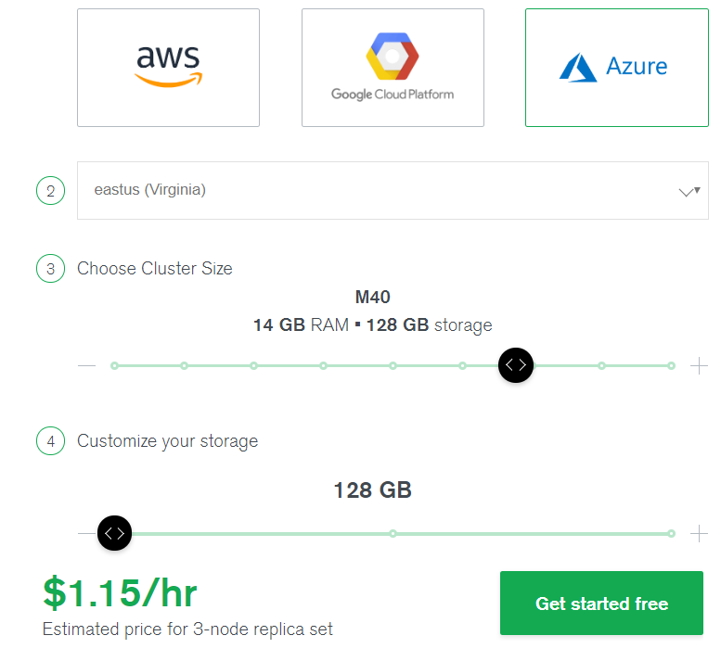

Slide 22
Hype

Slide 23
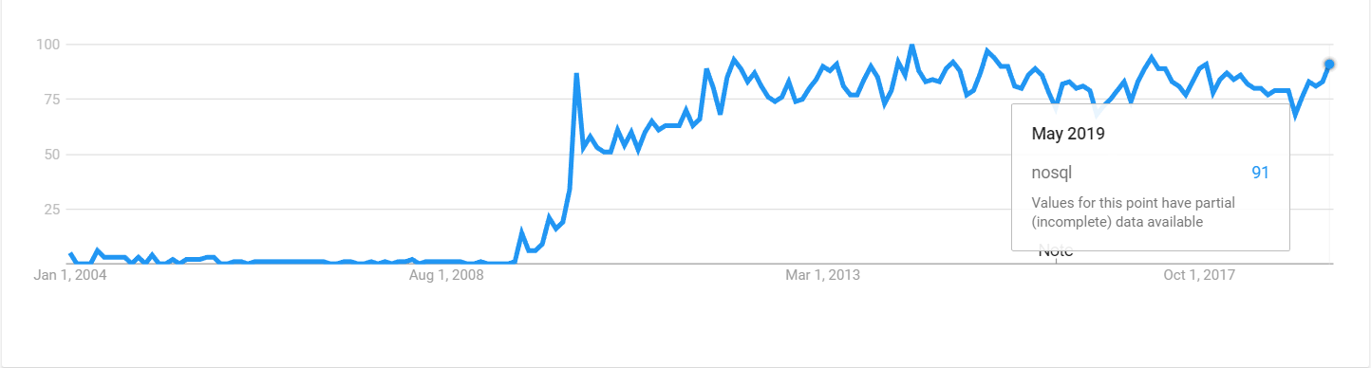
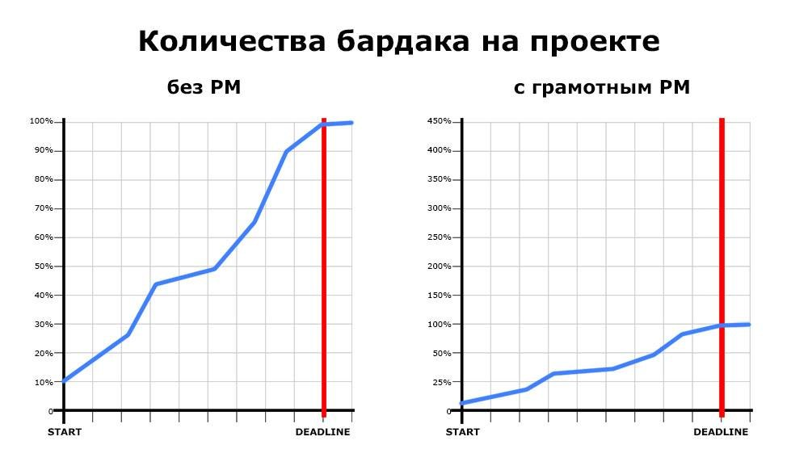
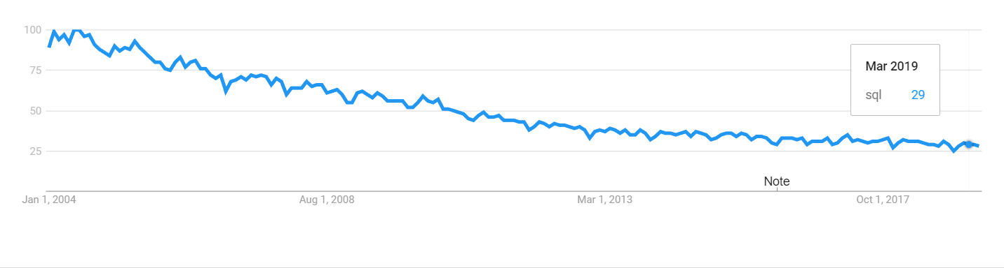

Slide 25
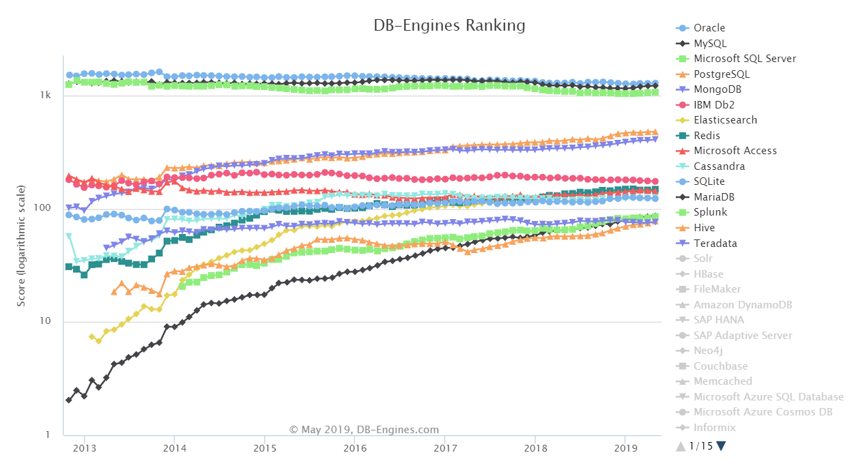
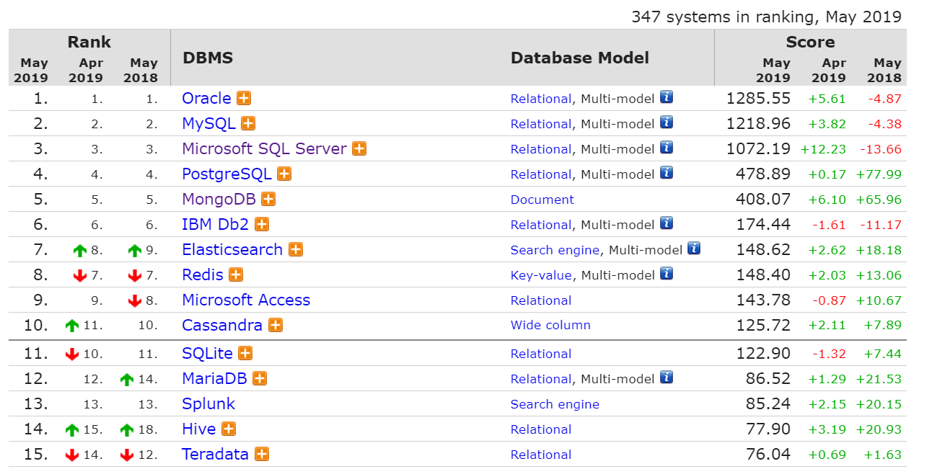

Slide 26
Black PR

Slide 27
Legacy

Slide 28
CPU – Cooperative Multitasking
Queries
CPUs
0
1
2
3
Time Quantum Length for each Scheduler is 4 ms

Slide 29
Select Data
Buffer Pool
Buffer Manager
Access Methods
Data Cache
Database File

Slide 30
Modify Data
Access Methods
Buffer Manager
Buffer Pool
Data Cache
Background Processes
Log Manager
Log Buffer
Database File
?
Transaction Log

Slide 31
PAGEIOLATCH_* Waits
1
SELECT * FROM Users
WHERE Name LIKE 'P%'
Runnable Queue
Schedulers
1
1
0
Non-Clustered Index
(Name)
A .. Z
1
A .. C
C .. Q
PAGEIOLATCH_SH
X .. Z
Suspended Queue
1
…
1
PAGEIOLATCH_SH
2
Buffer Pool
?
3
Database File

Slide 32
CX_PACKET
2s
1s
CXPACKET Wait
CXPACKET Wait
Thread 0
CXPACKET Wait
Thread 1
CXPACKET Wait
Thread 2
Thread 3
CXPACKET Wait
Thread 4

Slide 33
The Main Argument

Slide 34
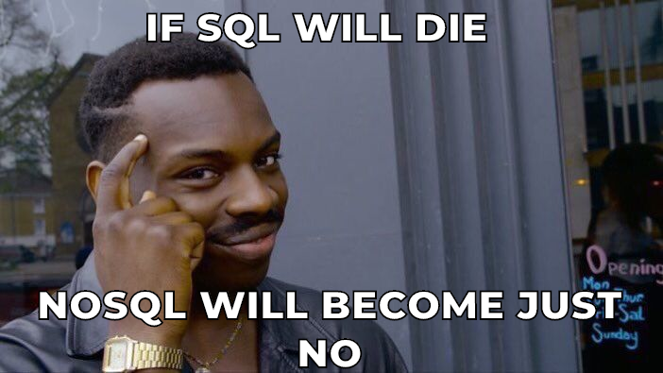

Slide 35
Thank You!
Denis Reznik
Twitter: @denisreznik
Email: denisreznik@gmail.com
Blog: http://reznik.uneta.com.ua
Facebook: https://www.facebook.com/denis.reznik.5
LinkedIn: http://ua.linkedin.com/pub/denis-reznik/3/502/234

