Slide 1
Iterating for Product-Market Fit and Getting Geared for Growth

Slide 2
Inspiration for new challengers and a warning to the established

Slide 3
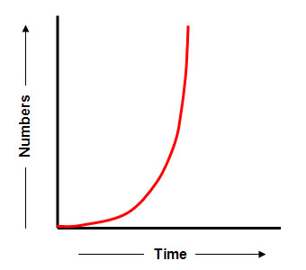
When markets are rapidly changing, there are only brief equilibrium states
Rapidly changing outside forces due to:
Technology
Culture
Customer Behaviour
Regulation
Market forces
New
Needs
Emerge
Change
Time

Slide 4
Make something people really want now
What’s Valuable?
Peter
Thiel
What Team
can do?
What’s Alternatives
Missing?
$500k -> $1b
2,000 X

Slide 5
How a latecomer like Google turned into the search monopoly?
vs
Narrow & Deep
Broad & Shallow

Slide 6
Start narrow & deep, then expand into new circles
Books
All Online Retail

Slide 7
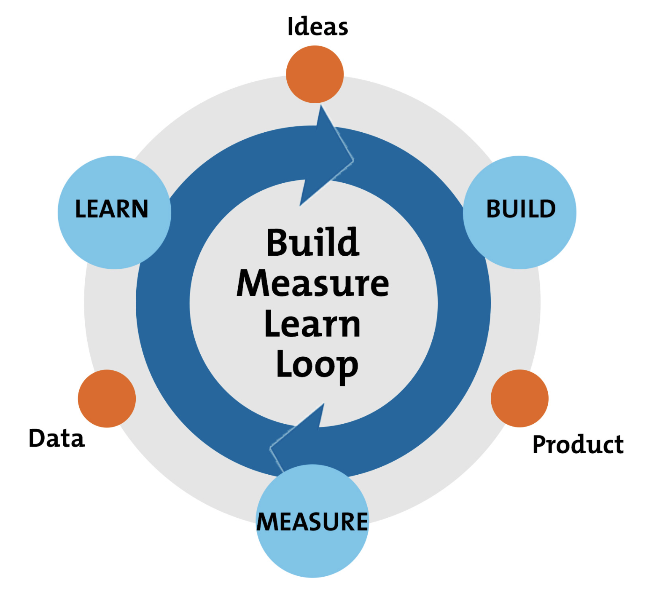
Building is straightforward, Collecting customer insights is not
Requires Observation & Empathy

Slide 8
How to collect customer insights for PMF: 1. Internalize the problem
Adora Cehung
PhD candidate but left to pursue startup opportunities.

Slide 9
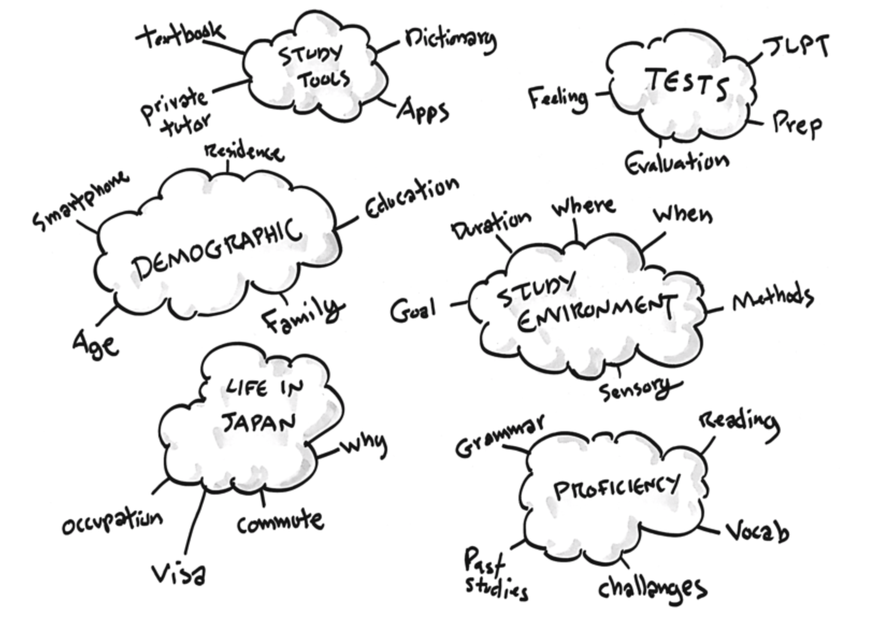
How to collect customer insights for PMF: 2. Listen to customer stories for discovery
Online Surveys
Friendly Talk
vs
Surveys are our creation, they are inherently biased
Open-ended, face-to-face, “human” interviews
* Businesses have human decision makers too

Slide 10
How to collect customer insights for PMF: 3. Identify patterns and outliers
Does A
Does A
Does A
Does A
Does A
Does A
Does B
Does A
Does A
Does B
Does A
Does A
Does A
Does A
Behaviours
Desires
Wants A
Wants A
Wants A
Wants A
Wants A
Wants A
Wants B
Wants A
Wants A
Wants B
Wants A
Wants A
Wants A
Wants A
10

Slide 11
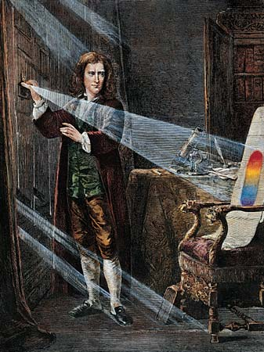
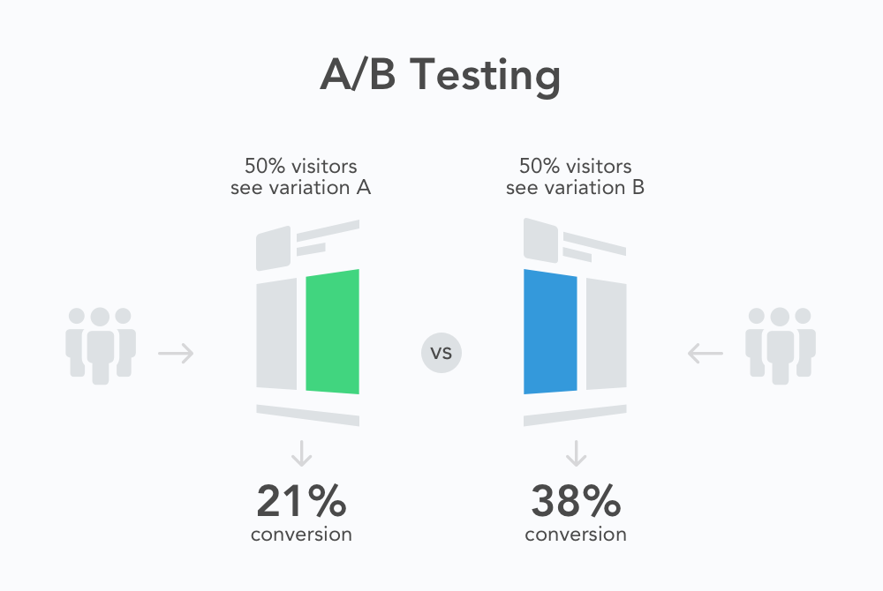
How to collect customer insights for PMF: 4. Apply and rigorously test your findings
Peter
Drucker
Entrepreneur = Business Experimentalist

Slide 12
How to collect customer insights for PMF: 5. Learn from your customer
* Prefer 1to1 meeting or a phone call
Who exactly is your customer?
Are they looking for a solution for somebody else?
Who is the decision maker, who will use the product?
Why do they need this solution?
If there is pain, there is a “Story”
Seek a “Story”: which experiences led you to our product?
What alternatives they tried/used?
Not only products but also alternative, manual ways if applicable
What matters them most about that problem?
If they had a magic wand, what would they do?

Slide 13
First find the PMF, only then try to Grow
Growth is costly, know when you’ve find the PMF
Find your OMTM (One Metric That Matters)
If your weekly OMTM growth < 5%: you are not a startup, pivot or continue iterating
Your OMTM should be your brutally honest friend
Put weekly OMTM changes on office wall, each team member should know and work for it with all heart
Step on gas and grow aggressively, when:
Weekly OMTM growth > 7%
Monthly churn < 5%
LTV > 3 X CAC

